Slide 1
Multi-omics Data In The Prediction Of Kidney Cancer Subgroups
Supervisor
Dr. Pratheeba J.
By
2018/E/073: Mr. Maduranga W.P.N.
2018/E/102: Mr. Rodrigo S.M.
Co-Supervisor
Dr. Thuseethan S.
EC6070 - COMPUTER ENGINEERING RESEARCH PROJECT

Slide 2
Introduction
Our Topic
Our research is related to the medical field and the goal is to classify Kidney cancer into its subgroups with a better accuracy. To accomplish that task, we have choose 3 main components known as,
Major subtypes of Kidney cancer
Multi Omics data
Machine Learning
Reason
Kidney cancer is a common cancer variant at present.
People who are elder than 60s are mostly affected by that and it's about 79,000 cases and about 14,000 people died among them.
Fortunately, it has a considerable possibility of getting safe if it can detect in the early stages.
2
Notes:
Clear cell
Papillary
Chromophobe

Slide 3
Literature Review
3

Slide 4
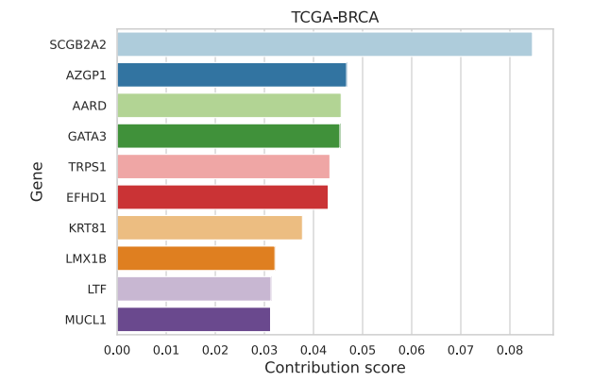
[1] Eloise Withnell, Xiaoyu Zhang, Kai Sun, Yike Guo, “XOmiVAE: an interpretable deep learning model for cancer classification using high-dimensional omics data”, Briefings in Bioinformatics, Volume 22, Issue 6, November 2021
This article introduces a new machine learning architecture known as XOmiVAE to increase the classification accuracy of different types of cancers.
They used single omics approach such as genomic data for data preparation
It followed a generalized behavior (Several Cancers) instead of specialization of Kidney cancer. Breast cancer and Kidney caners are their main targets.
Top 10 genes used for of breast invasive carcinoma ( Genomic data )
4
Notes:
[2.30]
VAE- variational auto encoders
XOmiVAE- ML model which can use for supervised and unsupervised classifications. Better for high dimensional data. It provides for contribution score for each features.

Slide 5
[2] Wu J, Jin S, Gu W, Wan F, Zhang H, Shi G, Qu Y and Ye D (2019) “Construction and Validation of a 9-Gene Signature for Predicting Prognosis in Stage III Clear Cell Renal Cell Carcinoma”
This article introduces a better approach to predict the status of stage III Renal Cell Carcinoma patients.
Only considered the Clear Cell RCC subgroup.
Paired t-test and Lasso Cox regression analysis for data analysis.
Used a Multi-omics data approach.
This article is useful to classify patients into High-risk and Low-risk categories.
5

Slide 6
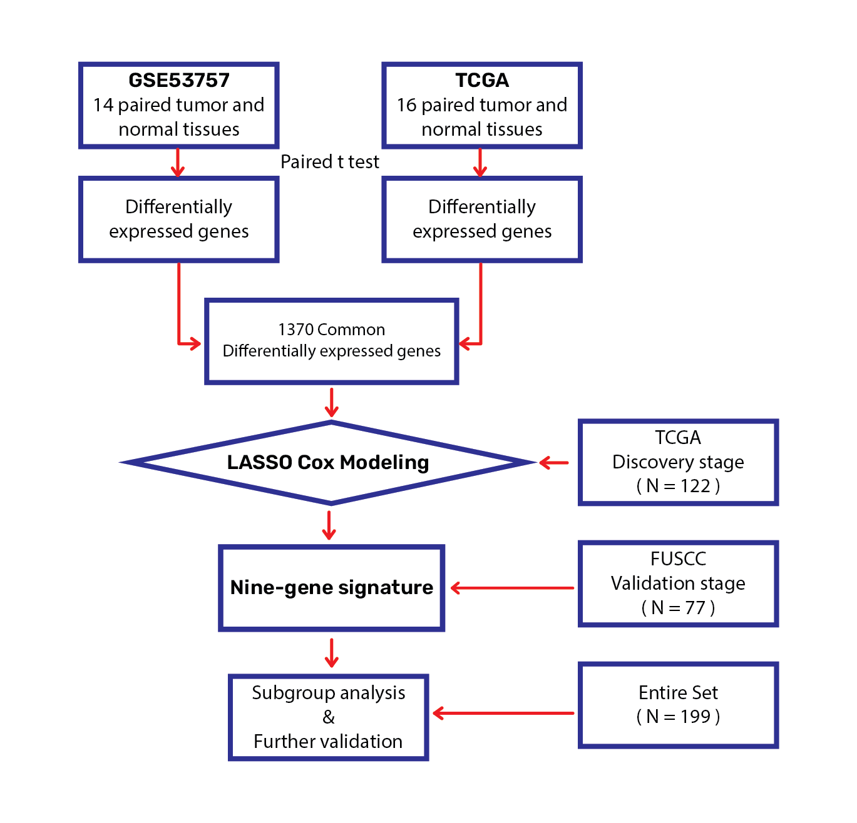
Flow chart of multi-gene signature identification and validation
6
Notes:
Differentially expressed genes can identified using paired t-test (1370 genes)
Then, we used a LASSO cox regression model and selected nine genes which highly associated with survival in these 1370 genes and 122 genes of TCGA.
Later, this nine-gene signature was tested with 77 samples of FUSCC stage.
Finally, subgroup analysis and further validation were performed for the entire 199 genes.

Slide 7
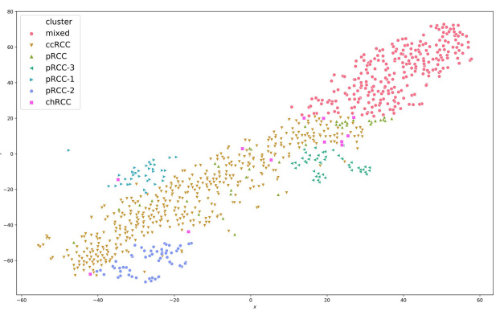
[3] Marquardt, André et al. “Subgroup-Independent Mapping of Renal Cell Carcinoma-Machine Learning Reveals Prognostic Mitochondrial Gene Signature Beyond Histopathologic Boundaries.” Frontiers in oncology vol. 11 621278. 15 Mar. 2021
This article focused on finding the survival rates inside and outside the mixed subgroup.
Considered only 3 main kidney cancer subtypes due to complexity.
Random Forest Machine Learning Technology is used to train the required model.
If following the single omic data approach for data preparation.
Separation of different clusters
7
Notes:
Random Forest- Builds decision trees on different samples and use for classification and regression

Slide 8
[4] Muhamed Ali, Ali, Hanqi Zhuang, Ali Ibrahim, Oneeb Rehman, Michelle Huang, and Andrew Wu. 2018. "A Machine Learning Approach for the Classification of Kidney Cancer Subtypes Using miRNA Genome Data" Applied Sciences 8, no. 12: 2422
They proposed a machine learning approach for the classification of kidney cancer subtypes using miRNA genome data.
They downloaded data from TCGA, through empirical studies they found the most discriminative miRNAs (#35) and group kidney cancer into 5 subtypes using a machine learning tool.
Kidney Renal Clear Cell Carcinoma
Kidney Renal Papillary Cell Carcinoma
Kidney Chromophobe
Rhabdoid Tumor
High-Risk Wilms Tumor
8
Notes:
[7.00] Let’s see how single omic classify…
Nearly 2000 miRNAs are available in TCGA
High weighted 35 features
Empirical studies – neighborhood component analysis (NCA)
ML tool – Long short term memory allgorithm

Slide 9
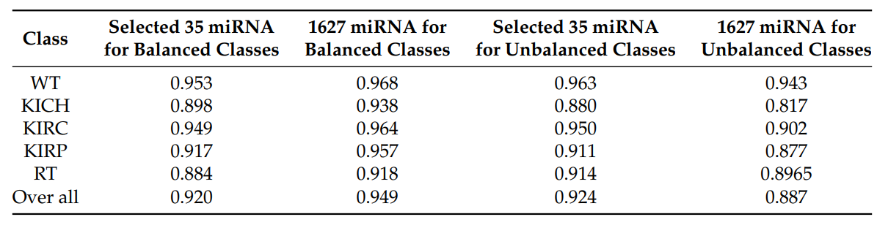
[4] Muhamed Ali, Ali, Hanqi Zhuang, Ali Ibrahim, Oneeb Rehman, Michelle Huang, and Andrew Wu. 2018. "A Machine Learning Approach for the Classification of Kidney Cancer Subtypes Using miRNA Genome Data" Applied Sciences 8, no. 12: 2422
The article is related to our research topic, as authors suggested that the identified miRNAs in this study can be used as biomarker candidates for kidney cancer subtype classification.
The problem in their work is, accuracy changes with the unbalanced datasets.
Classification performance
9
Notes:
75% patients diagnosed with clear cell
chromophobe.

Slide 10
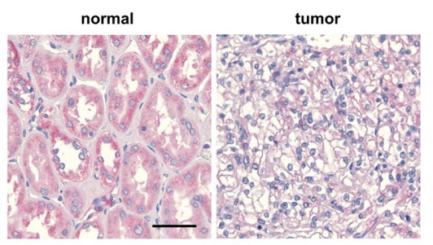
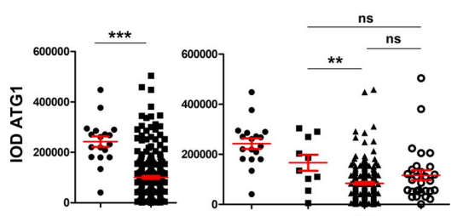
[5] He, Z., Liu, H., Moch, H. et al. “Machine learning with autophagy-related proteins for discriminating renal cell carcinoma subtypes”. Sci Rep 10, 720 (2020)
They tested the possibility for classify the subtypes of renal cell carcinomas (RCC) using autophagy proteins (ATGs), obtained from immunohistochemical (IHC) images (found from a Tissue microarray (TMA) from untreated patients and normal kidney tissues from healthy donors) of RCCs.
Sample representative image of IHC for ATG1
Integrated Optical Density presented as means and SEMs
10
Notes:
Now let’s see how protein….
IHC – it involves the process identifying protein in cells of a tissue section
IOD – Integrated Optical density reports the average intensity/density of each DAB-stained region.
Sem- standard error of the mean
Software- Pro plus
R language, including data cleaning and ML

Slide 11
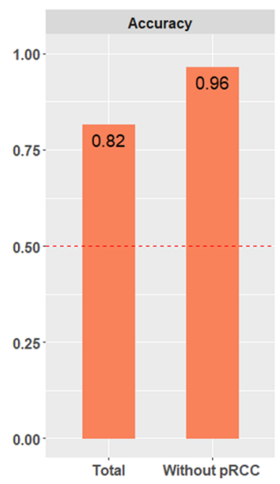
[5] He, Z., Liu, H., Moch, H. et al. “Machine learning with autophagy-related proteins for discriminating renal cell carcinoma subtypes”. Sci Rep 10, 720 (2020)
The article is related to our research topic, as authors suggested that the autophagy-related proteins can be used for kidney cancer subtype classification.
The problem in their work is, tested proteins less sufficient for papillary renal cell carcinomas (pRCC) prediction as compared with other subtypes.
Authors indicated that their model could even be improved if pRCC was not include.
Accuracies with and without pRCC
11

Slide 12
[6] Lovino, M., Bontempo, G., Cirrincione, G., Ficarra, E. (2020). “Multi-omics Classification on Kidney Samples Exploiting Uncertainty-Aware Models”. In: Huang, DS., Jo, KH. (eds) Intelligent Computing Theories and Application. ICIC 2020. Lecture Notes in Computer Science (), vol 12464. Springer, Cham.
In the multi-omic classification approach, a crucial step is represented by the algorithm by which to integrate the classification results from each omic.
One of the standard approaches is to make a consensus among the various omics, such that the multi-omic class is the most voted class among the outputs on the individual omics.
O/P 1
O/P 2
Target
O/P 3
However, this approach has two main limitations.
Same sample may assigned to different classes across the omics or there may no clear class prevalence.
Each omic carries characteristics that may not be present in the other omics.
12
Notes:
Now let’s see how multi omics classification happened…..

Slide 13
[6] Lovino, M., Bontempo, G., Cirrincione, G., Ficarra, E. (2020). “Multi-omics Classification on Kidney Samples Exploiting Uncertainty-Aware Models”. In: Huang, DS., Jo, KH. (eds) Intelligent Computing Theories and Application. ICIC 2020. Lecture Notes in Computer Science (), vol 12464. Springer, Cham.
This work proposes the use of a learning method consisting of a tree-based multi-layer perceptron (MLP), that for each omic (gene expression, microRNA expression, methylation) returns not only the corresponding class, but also its membership probability to that class.
Concerning the 37 stomach samples in training, all of them were correctly labelled as Unknown.
In real clinical practice, it is suitable to receive an Unknown label when the classifier is uncertain in its prediction.
13

Slide 14
Gap In The Literature
Mostly in the literature they considered ,
several cancers to classify the patients into their corresponding cancer or
a single kidney cancer subtype to further classify it into subgroups or
a single omic data to identify the Kidney cancer subgroups.
However in our research, we are considering the kidney cancer to classify into its most frequent subtypes (KIRC, KIRP and KICH) using different omic scale data (gene expression, methylation, miRNA and protein).
14
Notes:
[11.30] Let’s see the gap in the literature….
Clear cell very far away from rhabdoid tumor.

Slide 15
Data to be used in this work
The Cancer Genome Atlas (TCGA) Data Repository
For each subtypes (only KIRC,KIRP and KICH was available) we got following datasets.
DNA methylation → Methylation450k
gene expression → RNAseq
protein expression → reverse phase protein array (RPPA)
miRNA → IlluminaHiseq
15
Notes:
TCGA – a data repository which collected, characterized, and analyzed cancer samples from over 11,000 patients over 15 year period.
Latest techniques that used for analysis

Slide 16
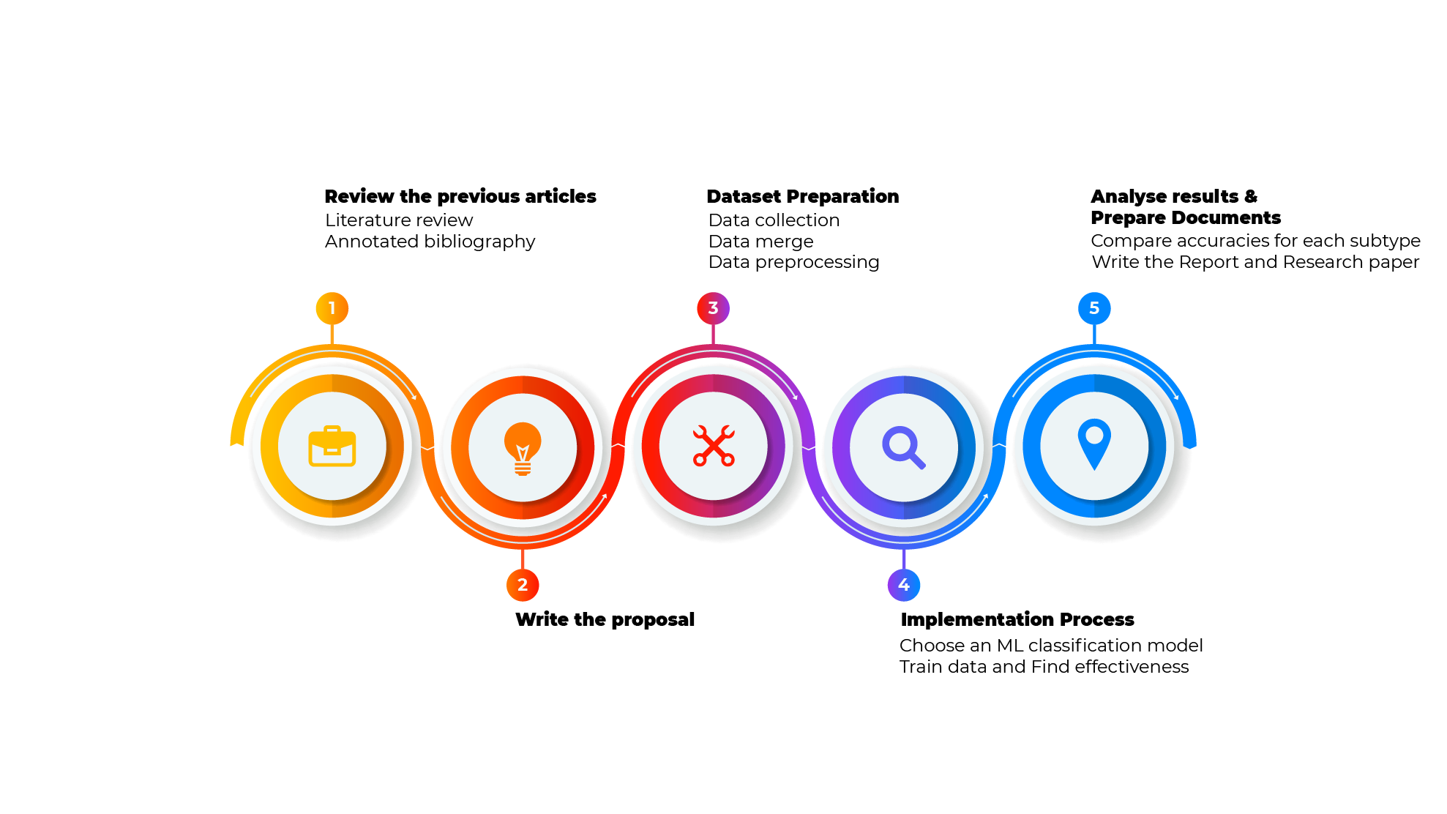
Work Plan
16
Notes:
[13.30]

Slide 17
Conclusion
Mostly, single omic data is selected and used in cancer related studies. Single omic may have some prediction drawbacks, so in our research we are going to test the use multiple omic data in the classification between kidney cancer subgroups.
As the treatment depends on this subgroup, a model with best accuracy will lead to a better treatment choice.
17
Notes:
[14.15]

Slide 18
References
Eloise Withnell, Xiaoyu Zhang, Kai Sun, Yike Guo, XOmiVAE: an interpretable deep learning model for cancer classification using high-dimensional omics data, Briefings in Bioinformatics, Volume 22, Issue 6, November 2021, bbab315, https://doi.org/10.1093/bib/bbab315
Wu J, Jin S, Gu W, Wan F, Zhang H, Shi G, Qu Y and Ye D (2019) Construction and Validation of a 9-Gene Signature for Predicting Prognosis in Stage III Clear Cell Renal Cell Carcinoma. Front. Oncol. 9:152. doi: 10.3389/fonc.2019.00152, https://doi.org/10.3389/fonc.2019.00152
Marquardt, André et al. “Subgroup-Independent Mapping of Renal Cell Carcinoma-Machine Learning Reveals Prognostic Mitochondrial Gene Signature Beyond Histopathologic Boundaries.” Frontiers in oncology vol. 11 621278. 15 Mar. 2021, doi:10.3389/fonc.2021.621278, https://doi.org/10.3389/fonc.2021.621278
Muhamed Ali, Ali, Hanqi Zhuang, Ali Ibrahim, Oneeb Rehman, Michelle Huang, and Andrew Wu. 2018. "A Machine Learning Approach for the Classification of Kidney Cancer Subtypes Using miRNA Genome Data" Applied Sciences 8, no. 12: 2422. https://doi.org/10.3390/app8122422
18

Slide 19
References
He, Z., Liu, H., Moch, H. et al. Machine learning with autophagy-related proteins for discriminating renal cell carcinoma subtypes. Sci Rep 10, 720 (2020). https://doi.org/10.1038/s41598-020-57670-y
Lovino, M., Bontempo, G., Cirrincione, G., Ficarra, E. (2020). “Multi-omics Classification on Kidney Samples Exploiting Uncertainty-Aware Models”. In: Huang, DS., Jo, KH. (eds) Intelligent Computing Theories and Application. ICIC 2020. Lecture Notes in Computer Science (), vol 12464. Springer, Cham. https://doi.org/10.1007/978-3-030-60802-6_4
19

Slide 20
Thank You!

